Slide 1

Computers
Whitiora

Slide 2
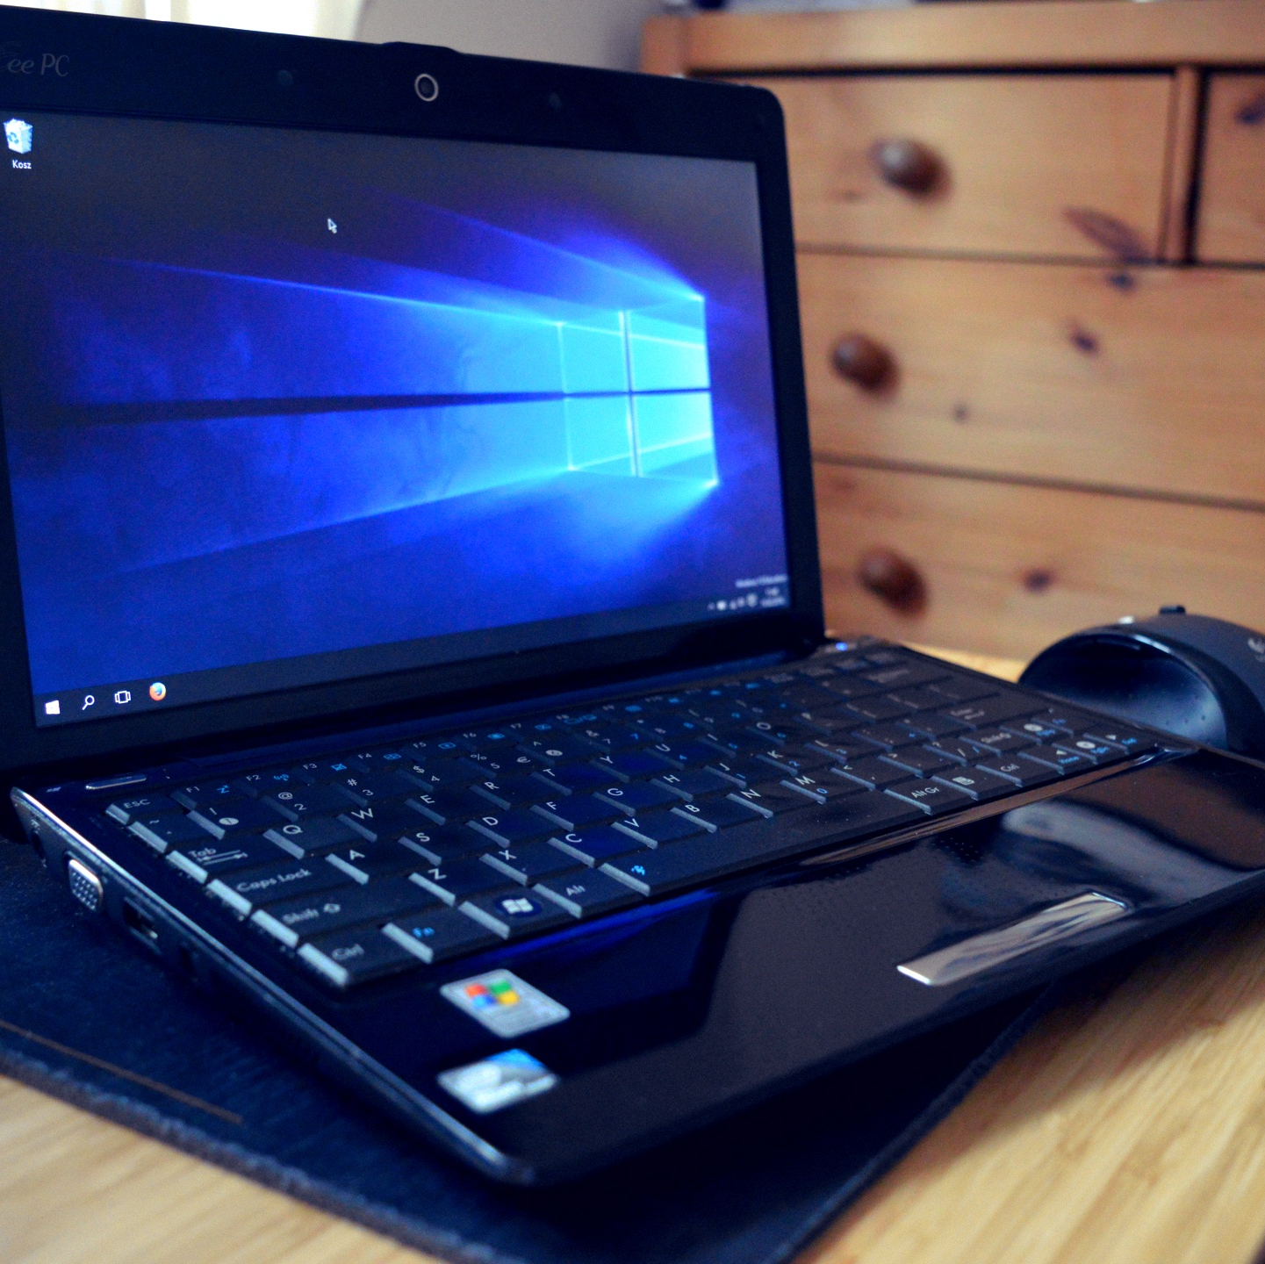

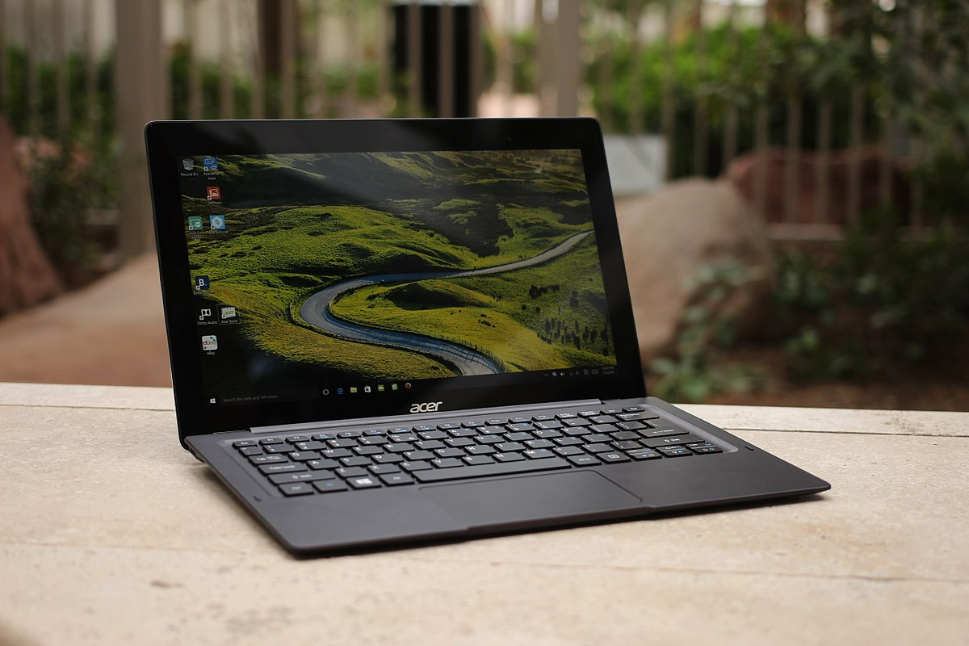
Agenda
Introduction – (what is this all about)
Getting Started – (what research did you do)
Interview Description – (who was the user, what are their needs)
Selection – (explain a few considerations)
Justification – (why does this fit the users needs)
This Photo by Unknown Author is licensed under CC BY-SA

Slide 3
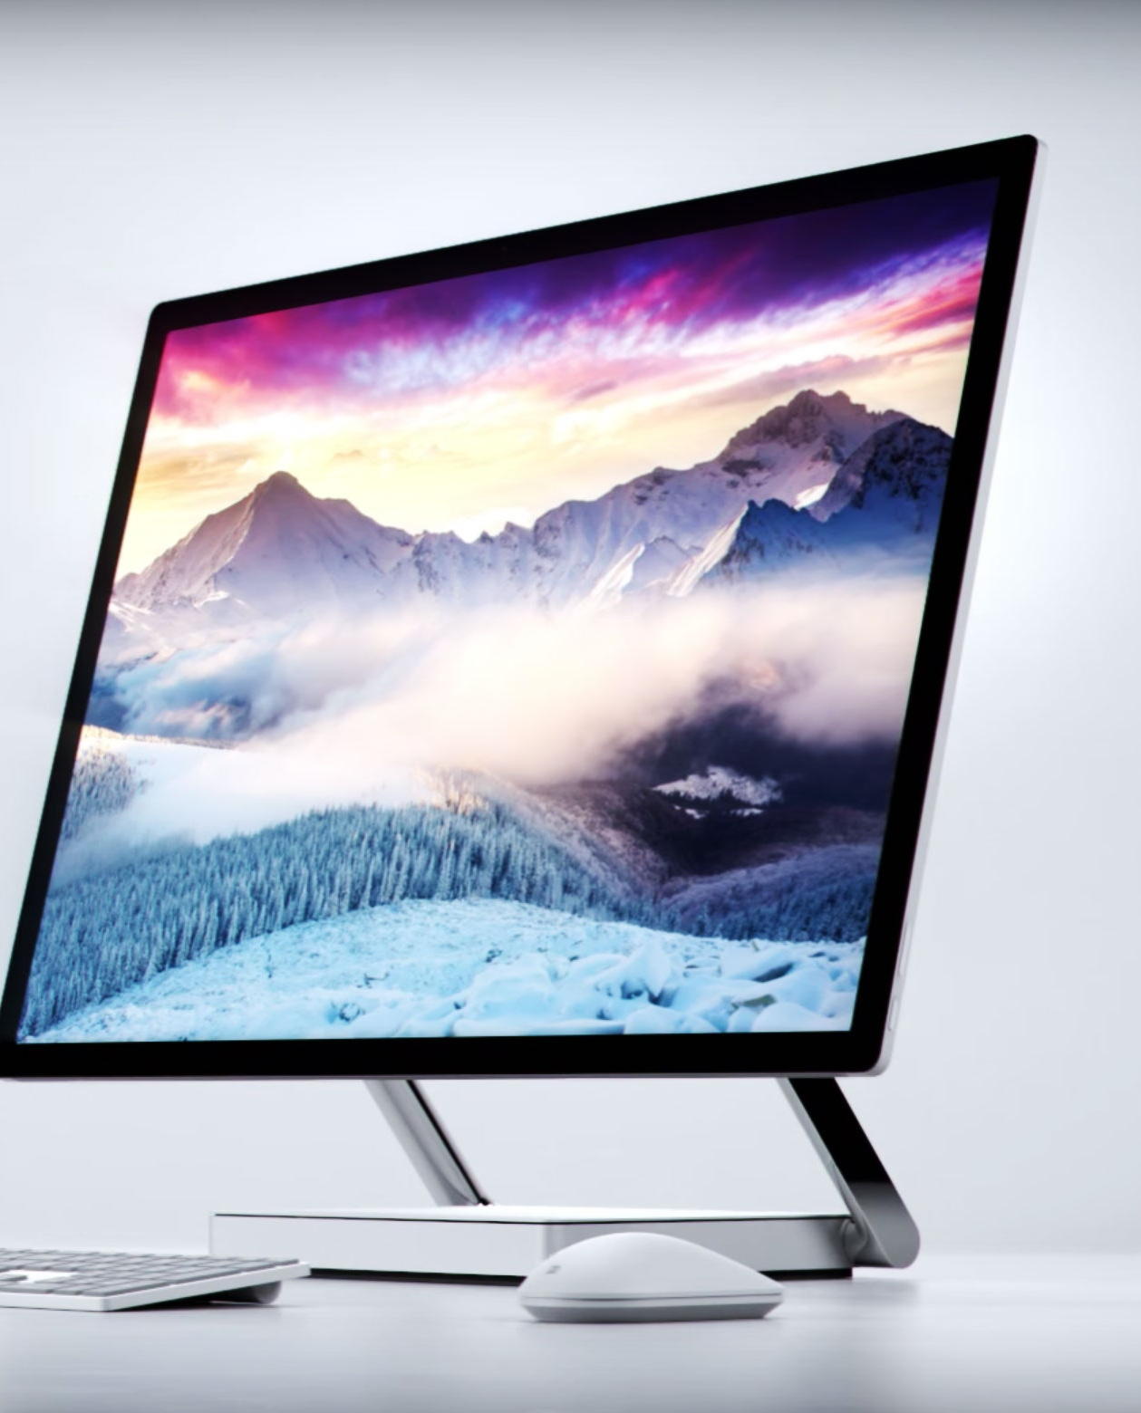
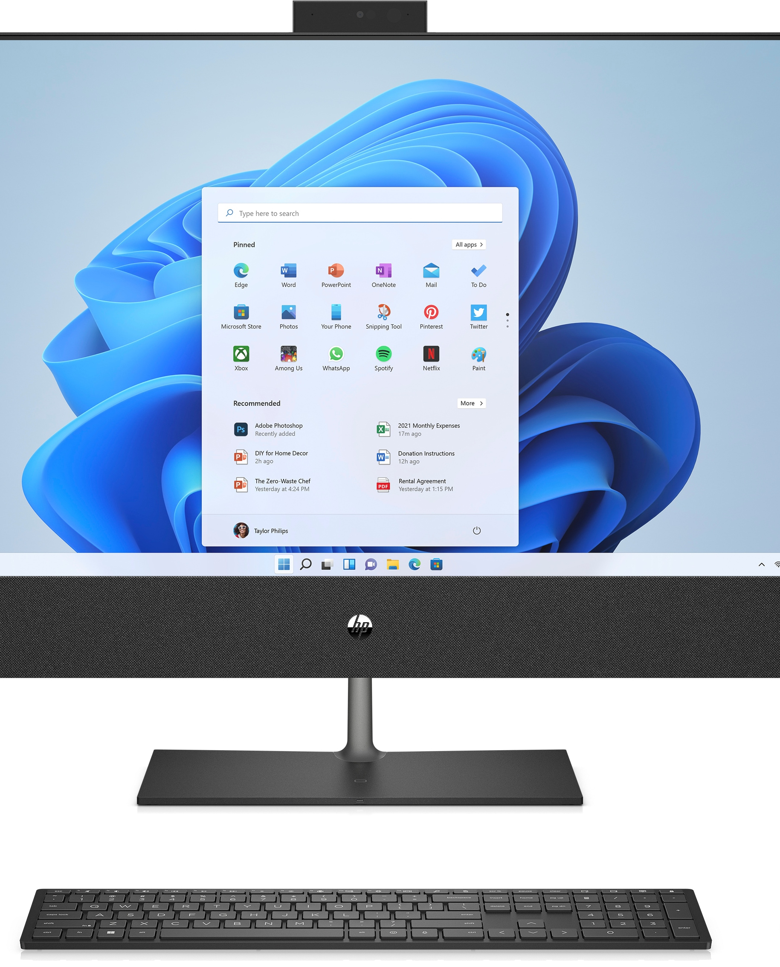
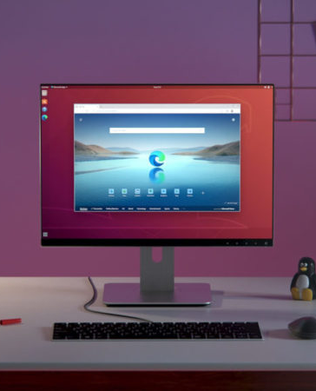
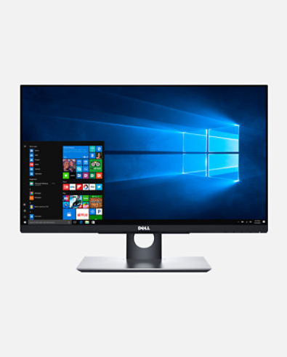
Introduction
Hi my name is Whitiora, and my PowerPoint is about computers. In class we have been learning about different parts of a computer and how they function. I also got to take apart an old PC and see all the parts inside of it, later my team and I had to try put it back together again.

Slide 4

Getting Started
The research that I done was to find out what each part of the computer was used for, for example a monitor is used for a display's information in pictorial or textual form.

Slide 5
Interview Description
The person I interviewed was my mum, my mum used a computer at her work, She works at Te Ahurea at the receptionist. She used it to email her work mates and others. Her needs were that she needed another desktop computer cause her one was getting old, and it needed to be updated. That’s why I recommended for her to get the Dell OptiPlex 7460 computer.

Slide 6
Selection
I presented my Mum four options of computers to choose from. An Apple M1 chip, A Dell OptiPlex 7400 , Apple iMac 24 and a Lenovo s500 desktop, I got her to pick from these four options because some of them were cheap and some where not so cheap. She decided to pick the Dell OptiPlex 7460 computer.

Slide 7
Justification
The Dell OptiPlex 7460 computer was best for mum because it was easy to use, and it was newer than her old one. She decided to chooses this computer because she liked how it looked and she had heard good reviews on the model.

Slide 8
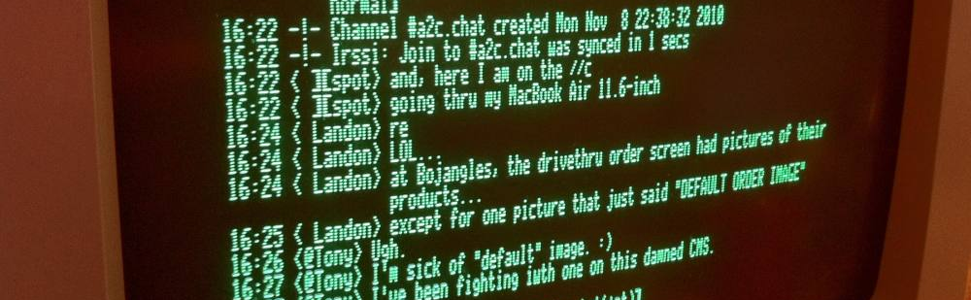
Summary
This Photo by Unknown Author is licensed under CC BY-SA-NC
In conclusion, I think that the person I interviewed should get the Dell OptiPlex 7460 computer, because it will make their job easier now and, in the future. I think this because I have read the reviews and it says that this is a great computer to buy, it will also last a long time. The computer only costed $999.

Slide 9
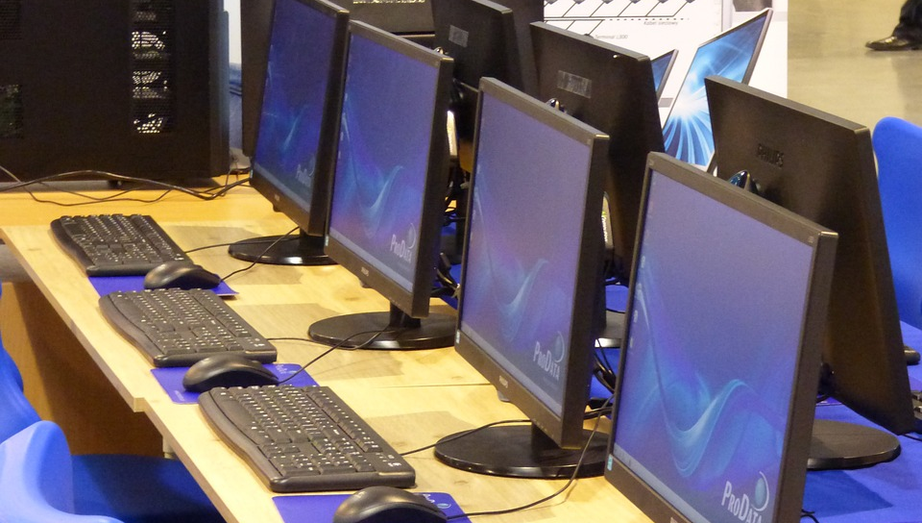
Thank You
Whitiora
Wbrady-brown@stu.kerikerihigh.ac.nz
This Photo by Unknown Author is licensed under CC BY-SA

